Slide 1
‘See, I am doing a new thing!’ Isaiah 43:19

Slide 2
A Global Psalm of Praise
Holy God,
we praise you because ………

Slide 3
Revelation 21:1-5a A New Heaven and a New Earth
21 Then I saw “a new heaven and a new earth,” for the first heaven and the first earth had passed away, and there was no longer any sea. ² I saw the Holy City, the new Jerusalem, coming down out of heaven from God, prepared as a bride beautifully dressed for her husband. ³ And I heard a loud voice from the throne saying,
1/2

Slide 4
“Look! God’s dwelling place is now among the people, and he will dwell with them. They will be his people, and God himself will be with them and be their God. ⁴ ‘He will wipe every tear from their eyes. There will be no more death or mourning or crying or pain, for the old order of things has passed away.” ⁵ He who was seated on the throne said, “I am making everything new!”
2/2

Slide 5
Revelation 22:1-5 Eden Restored
22 Then the angel showed me the river of the water of life, as clear as crystal, flowing from the throne of God and of the Lamb ² down the middle of the great street of the city. On each side of the river stood the tree of life, bearing twelve crops of fruit, yielding its fruit every month. And the leaves of the tree are for the healing of the nations.
1/2

Slide 6
³ No longer will there be any curse. The throne of God and of the Lamb will be in the city, and his servants will serve him. ⁴ They will see his face, and his name will be on their foreheads. ⁵ There will be no more night. They will not need the light of a lamp or the light of the sun, for the Lord God will give them light. And they will reign for ever and ever.
2/2

Slide 7
One New Thing…..
Please use the Q and A function to tell us what God has been doing in your Unit.
What new vision is God giving you?

Slide 8
World Federation News
World Secretary: Mataiva Robertson
World Vice President: Matilda Johnson
World Treasurer: Leu Pupulu
President Emerita: Ann Connan
World President: Alison Judd

Slide 9
Federation Day Study Resource 2021
Prepared by South Asia Area
SDG 6
Clean Water and Sanitation
www.wfmucw.org/publications

Slide 10
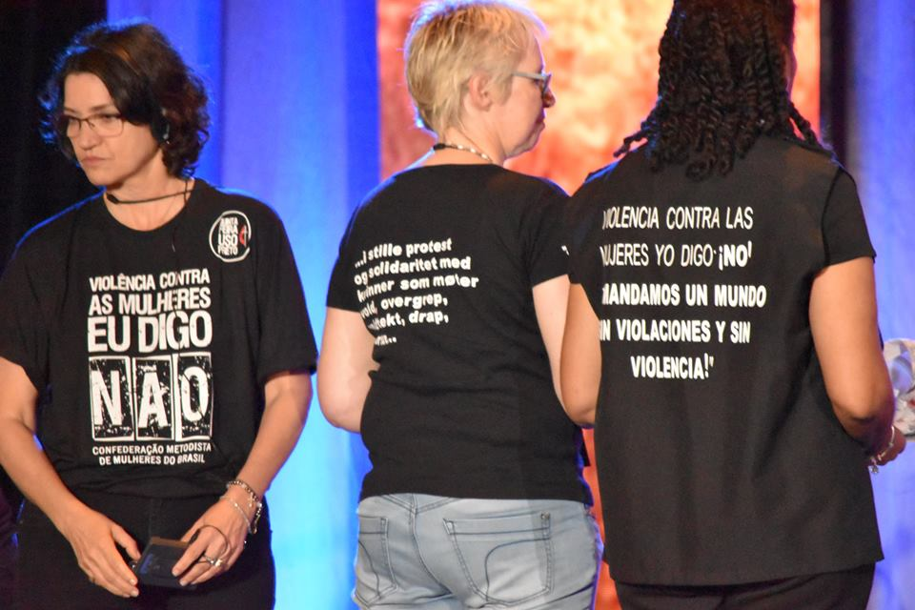
Proclaiming through social action

Slide 11
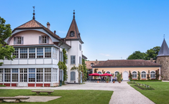
Bossey Scholarship
Educational opportunities at the Ecumenical Institute thanks to a grant from
United Methodist Women

Slide 12
Prayer is the powerhouse that generates results

Slide 13
From Lake Junaluska, North Carolina to
Atlanta, Georgia

Slide 14
Former home of our WFMUCW display cabinets that were changed at least annually.

Slide 15
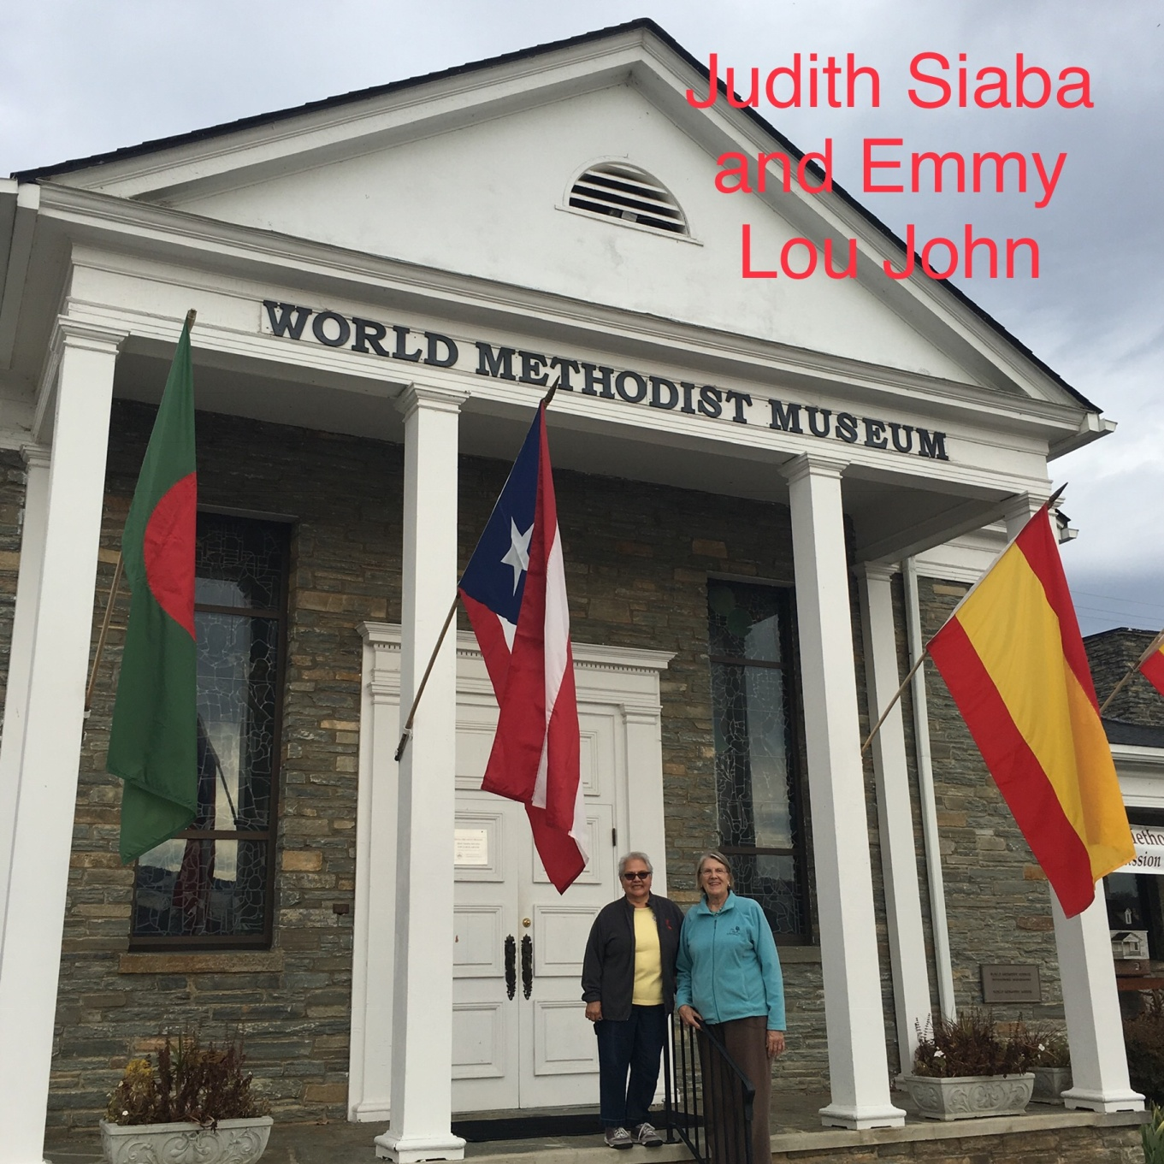
Left – Judith Siaba, 2016-2022 Archivist
Right – Emmy Lou John, 2011-2016 Archivist
Our Archives were first housed in the basement of the World Methodist Museum before being moved to Epworth Building.

Slide 16
Epworth building held our materials in the basement for many years. After a flood the files were moved to the top floor.

Slide 17
Display cabinets inside the Methodist Museum which told our story to all who visited the museum

Slide 18
Our files being taken from their shelves in Lake Junaluska. Over 75 years of records that tell our story in mission.

Slide 19
A full van filled with OUR Herstories.

Slide 20
Putting in the last file box in the front. Goodbye Lake Junaluska, heading to Atlanta, Georgia.

Slide 21
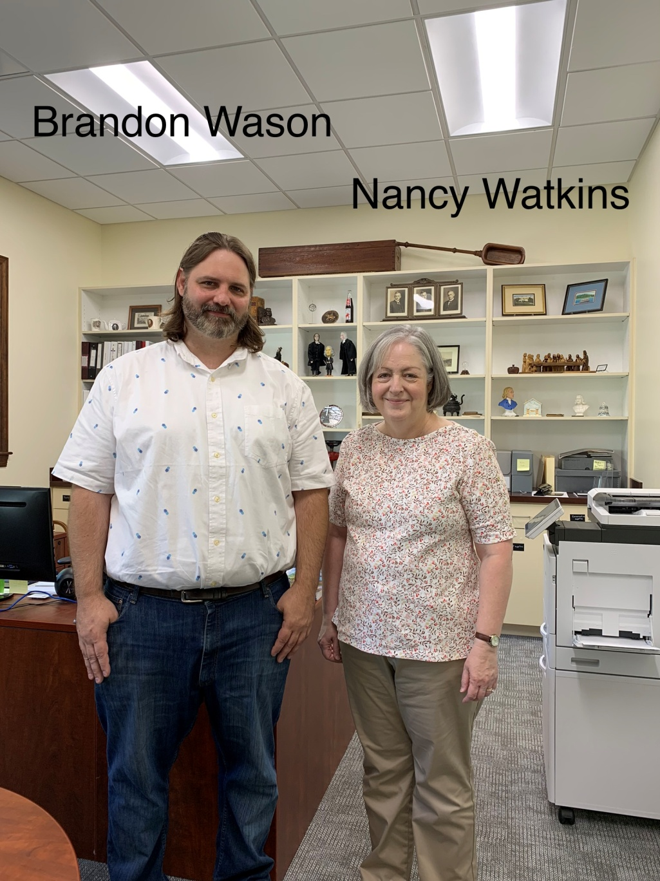
Nancy Watkins, the archivist for the South Eastern Jurisdiction of the UMC in the United States has been a Godsend. She has helped organize all of our Archives in a professional manner in the past 7 years.
Brandon Wason, from Pitts Library, is the new keeper of our Archives. We are looking forward to working with him in the future so that our archives will continue to be updated and available to all upon request.

Slide 22
Thank you, Nancy Watkins, for all of your help. I will miss our annual visits.
Judith Siaba
WFMUCW Archivist

Slide 23
Pitts Theology Library
New home of the World Federation of Methodist and Uniting Church Women Archives. Pitts Library is located on the campus of Emory University and is part of Candler School of Theology in Atlanta, Georgia.

Slide 24
The Federation prayer Written by WFMW Executive members, 1986-91
Creator God, rooted in your loving care,
Nurtured through your Son Jesus,
Challenged by your Holy Spirit,
We are in the world to bring peace with justice,
Reconciliation in love, and hope for all people.
May our lives extend as the branches of our Tree of Life,
Bearing fruit of Unity and Love.
We offer praise and thanksgiving
Through our Lord and Saviour Jesus Christ. Amen

Slide 25
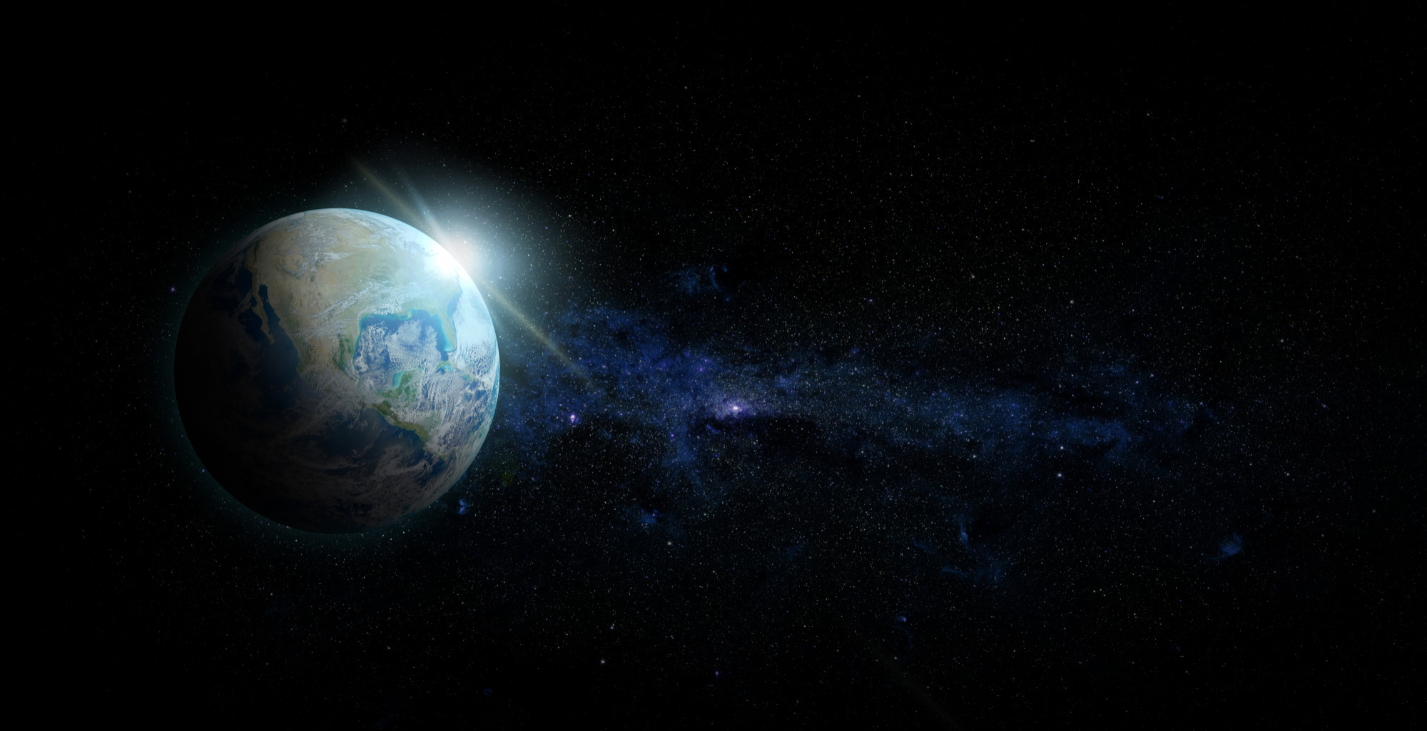
“If the Earth were only a few feet in diameter, floating a few feet above a field somewhere, people would come from everywhere to marvel at it.
People would walk around it marvelling at its big pools of water, its little pools and the water flowing between.
People would marvel at the bumps on it and the holes in it.
They would marvel at the very thin layer of gas surrounding it and the water suspended in the gas.
The people would marvel at all the creatures walking around the surface of the ball and at the creatures in the water.
The people would declare it as precious because it was the only one, and they would protect it so that it would not be hurt.
The ball would be the greatest wonder known, and people would come to behold it, to be healed, to gain knowledge, to know beauty and to wonder how it could be.
People would love it, and defend it with their lives because they would somehow know that their lives could be nothing without it.
If the Earth were only a few feet in diameter.”
Joe Miller

Slide 26
Songs and hymns day one StF = Singing the Faith hymnbook CCLI#705701
Yesuvai Pol Alagullor KINGDOM LADIES of Methodist Women of the Tamil Methodist Church , Tamil Settlement, Ipoh, Malaysia.
Bind us together‘ Voices and musicians of North Shields and Whitley Bay Methodist Circuit’
Mas Alla Del Sol (Far beyond the sun) Latin America women’s choir
StF 545 Be thou my Vision ‘Sophie Hambley on vocals and Oliver Hack on keys’. St James Road Methodist Church Southampton UK
World Federation song taken from www.wfmucw.org
We will meet (John Bell) Sunday Worship with John Bell - The Iona Community

Slide 27
‘The earth is the Lord’s and everything in it, the world and all who live in it.’ Psalm 24:1

Slide 28
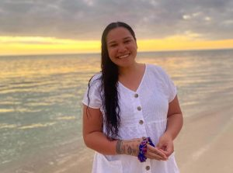
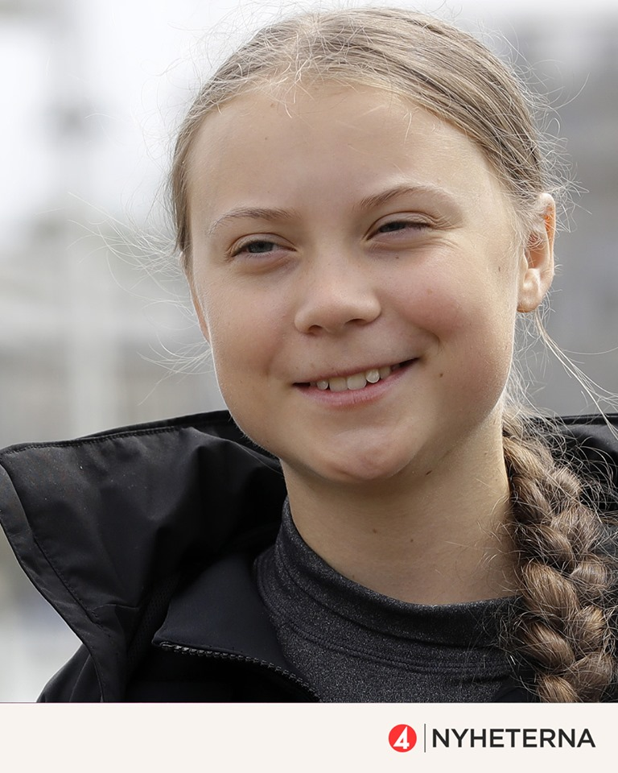
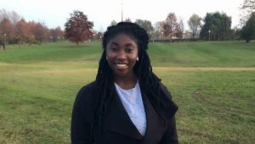
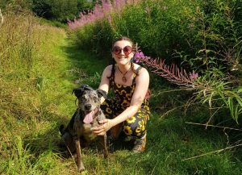
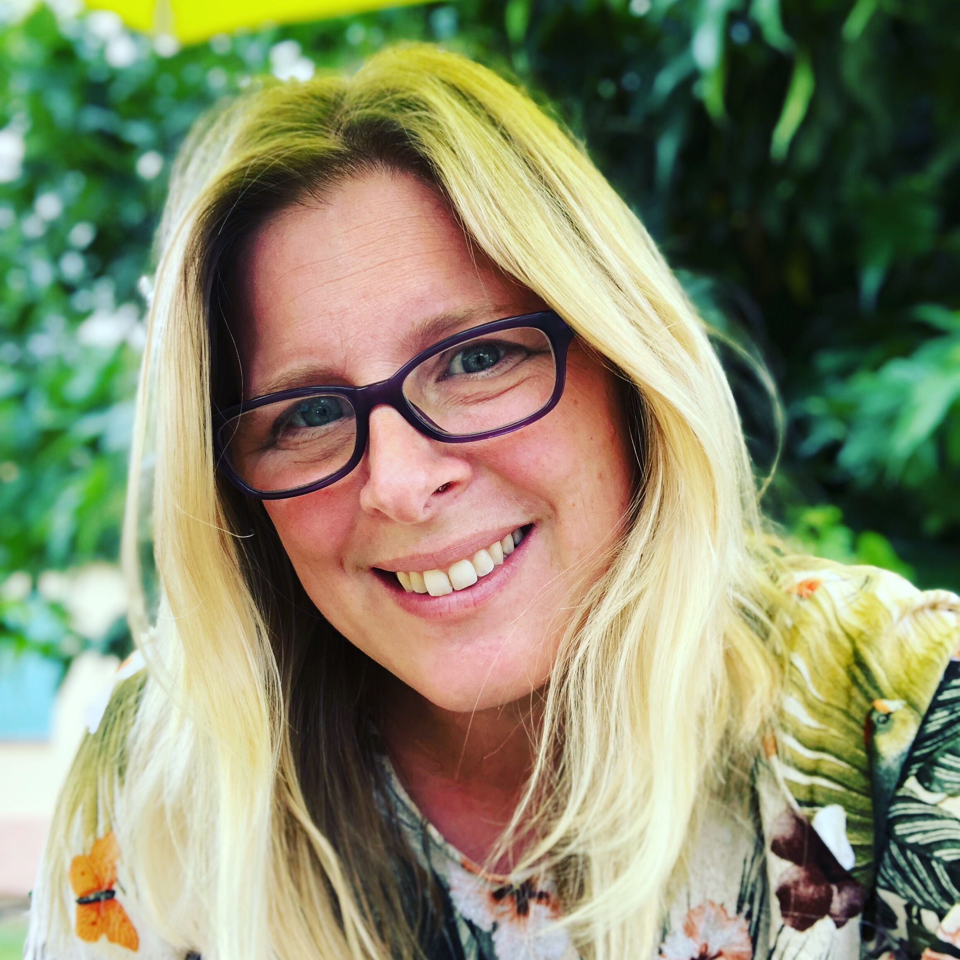
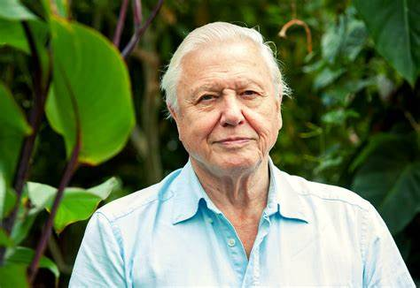
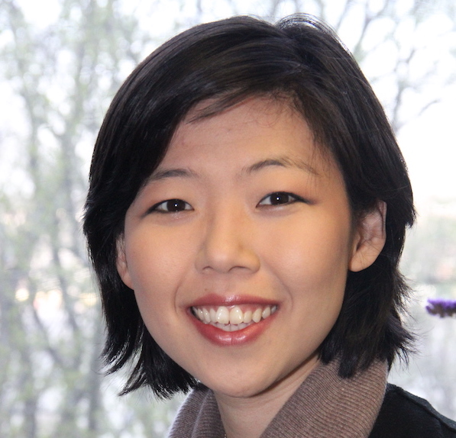
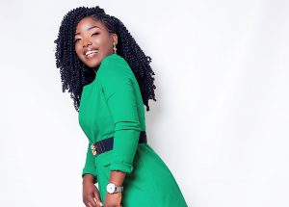
Visionaries calling for climate action

Slide 29
COP 26

Slide 30
‘Living in tune with our planet’
Our thanks to Methodist Women in Britain, Jo Swinney from A Rocha International, Liz Lee of United Methodist Women and Climate Justice for All ambassadors for their contributions to day 2 of this event.

Slide 31
‘The earth is the Lord’s and everything in it, the world and all who live in it.’ Psalm 24:1

Slide 32
Prayers of adoration and thanksgiving: led by Carolyn Lawrence, British Unit
……. Lord of Life; we praise and adore you

Slide 33
Jo Swinney
Our guest speaker is Director of Communications at A Rocha International
www.arocha.org

Slide 34
INSERT JO SWINNEY’S Slides here?

Slide 35
Prayers of confession led by Lois Grant-Hector, North America and MCCA
Lord, forgive us and help us to know and do your will

Slide 36
The Lord’s Prayer
Our Father in heaven, hallowed be your name.
your kingdom come, your will be done,
on earth as in heaven.
Give us this day our daily bread.
Forgive us our sins
as we forgive those who sin against us.
Save us from the time of trial
and deliver us from evil.
For the kingdom, the power and the glory are yours,
Now and for ever. Amen

Slide 37
Liz Lee
Elizabeth Chun Hye LEE
Executive for Economic and Environmental Justice
Climate Justice Lead
United Methodist Women
www.unitedmethodistwomen.org/climate-justice

Slide 38
Prayers of intercession led by Louise Wilson, Britain and Ireland
Lord hear us, Lord graciously hear us

Slide 39
A call to action

Slide 41
More resources for action

Slide 42
You are invited to make a donation to the WFMUCW
PRAYER FOR DONATION:
May the gifts we made, be gifts of love,
May the donations we give, be offerings of our hearts,
May each gift be blessed by your grace,
That other may know the truth of your wisdom and your love.
In your name, Jesus Christ, we pray.
AMEN
Use the donate button on our website www.wfmucw.org or contact our World Treasurer Leu Pupulu world.treasurer@wfmucw.org

Slide 43
Pledge to Creation
We, who know the love of the Creator through the life, death and resurrection of Jesus, the Christ, are called:
to honour earth as the one place in the universe which God has chosen to dwell;
1/8

Slide 44
Pledge to Creation
to respect creation as inter-connected living relationships held together by the power of God in the rhythm of life;
2/8

Slide 45
Pledge to Creation
to love earth completely as God did by sending God’s only Son Jesus to reconcile all things on earth with God;
3/8

Slide 46
Pledge to Creation
to oppose those powers which plunder the limited resources of this planet for profit and take food from the poor to feed the greed of the rich;
4/8

Slide 47
Pledge to Creation
to suffer with our weakening earth as we listen to the cries of pain from its forests, its rivers, its farmlands, its oceans and its atmosphere struggling against the forces of death;
5/8

Slide 48
Pledge to Creation
to celebrate the hope of the earth as it resists the poisons that threaten its life, the pollution that denigrates its goodness, and recovers from nuclear explosions and deforestation;
6/8

Slide 49
Pledge to Creation
to care for the earth as a family cares for each member – not dominating or merely using as objects – but respected because all parts are beloved creations of God.
7/8

Slide 50
Pledge to Creation
And to all this we say a resounding YES!
8/8

Slide 51
The Blessing
“The Lord bless you and keep you; the Lord make His face to shine upon you
and be gracious to you; the Lord turn his face towards you and give you peace.”
Numbers 6: 24-26

Slide 52
Thanks and Acknowledgements
With grateful thanks to our speakers:
Jo Swinney, Director of Communications, A Rocha International
Liz Lee, Climate Justice Lead, United Methodist Women
Climate ambassadors Mollie, Irene, Jessica and Maima
Hilary Evans, former President of Methodist Women in Britain
Romsey Methodist Church ECO church gold award winners
Members of the World Executive of the WFMUCW
Rachel Allison and other Helen Kim Memorial Scholars
Our amazing team of translators
Russell, Pete and James at P H Productions for their technical ability and support.

Slide 53
Hymns and prayers day two CCLI licence #705701
StF 27 Jesu Tawa Pano sung by Sipiwe Chisvo, Patricia Mapani and Rebecca Matongo. Words and Music: Patrick Matsikenyiri ©1990, 1996 administered by General Board of Global Ministries, t/a GBGMusik, Atlanta, GA, USA. Permission granted for use.
StF 82 O Lord my God (How Great thou art) Methodist Central Hall Westminster (MCHW) UK
StF 727 God in his love for us lent us this planet ‘Voices and musicians of North Shields and Whitley Bay Methodist Circuit’
StF 663 I the Lord of Sea and Sky soloist David Quah Hong Kong. Words and music by Daniel L Schutte, copyright OCP Publications, Portland, Oregon , USA.
StF 51 Great is thy faithfulness’, MCHW
Prayers written by members of Methodist Women in Britain www.mwib.org.uk
Pledge for Creation can be found on our website in Study day program 2017

Slide 54
Videos from other sources used with permission
Psalm 65 A Rocha
Reforestation in Peru A Rocha
Fiji - Rising sea levels/forced migration Maima Climate Justice for All
A prayer for the Moana (Ocean) written and read by The Most Reverend Archbishop Winston Halapua of the Diocese of Polynesia, Anglican Church of Aotearoa / New Zealand and produced by Rev. James Bhagwan, Secretary for Communication and Overseas Mission of the Methodist Church in Fiji and Chaplain/Trustee of the Traditional Voyaging Canoe the Uto Ni Yalo.

